Slide 1

Smart WATER LEVEL MEASURING SYSTEM
9.01.2024
Technical university of cluj napoca
COMPUTER NETWORKS

Slide 2
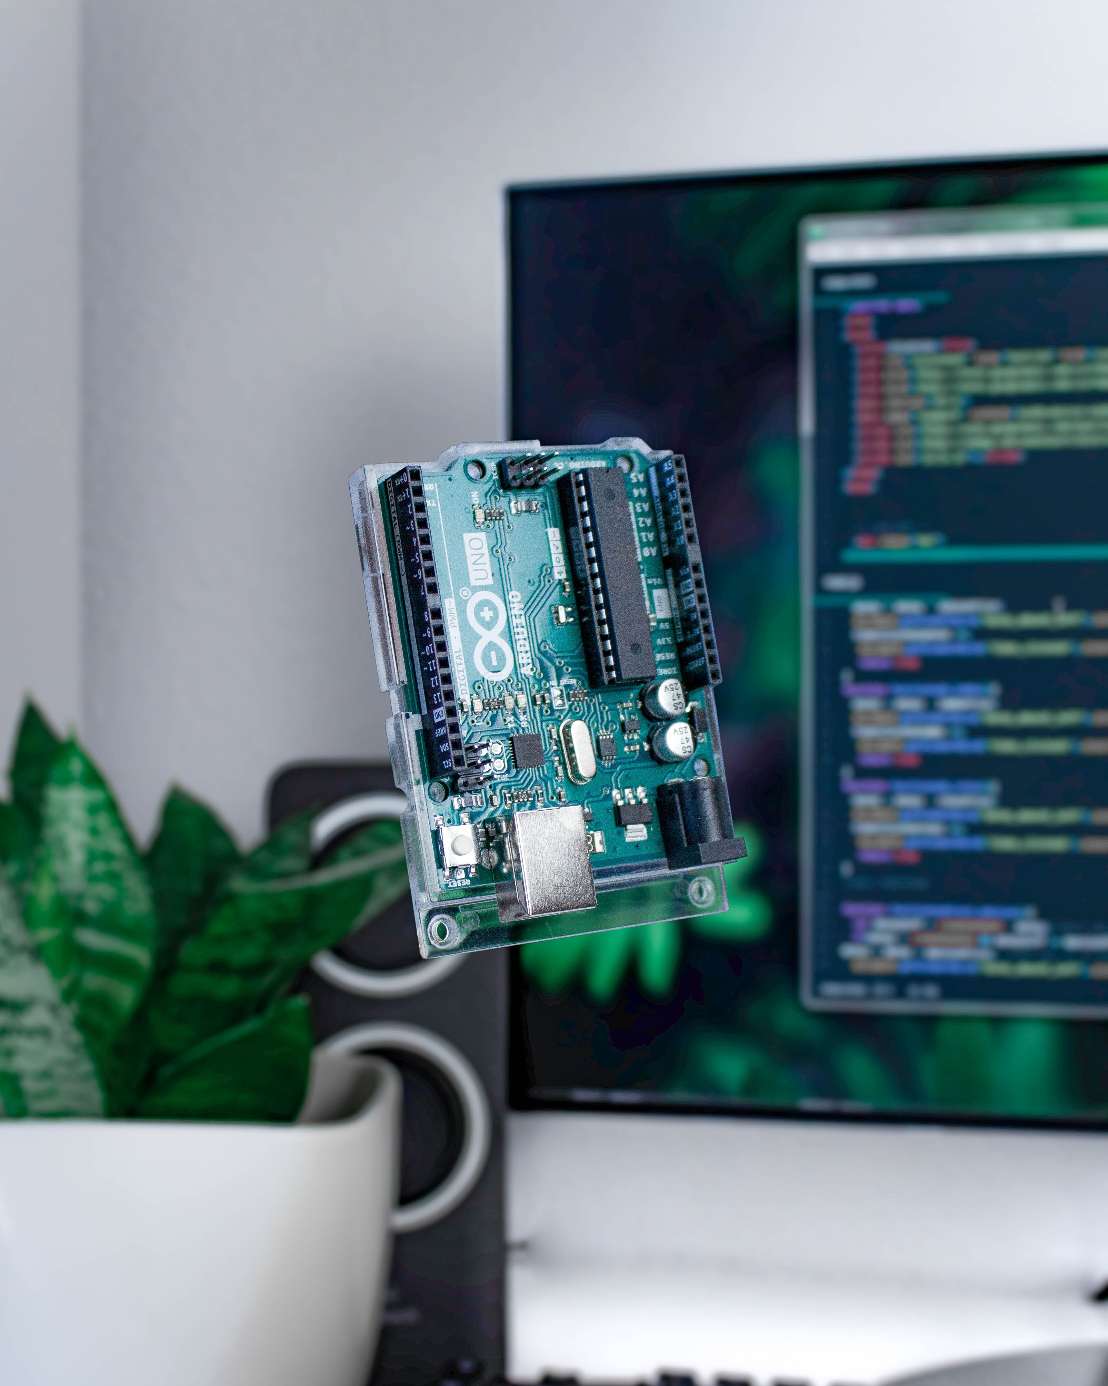
Contents
PROJECT INTRODUCTION
OPERATION
IMPLEMENTATION
WHAT’S NEXT
CLOSING
2

Slide 3
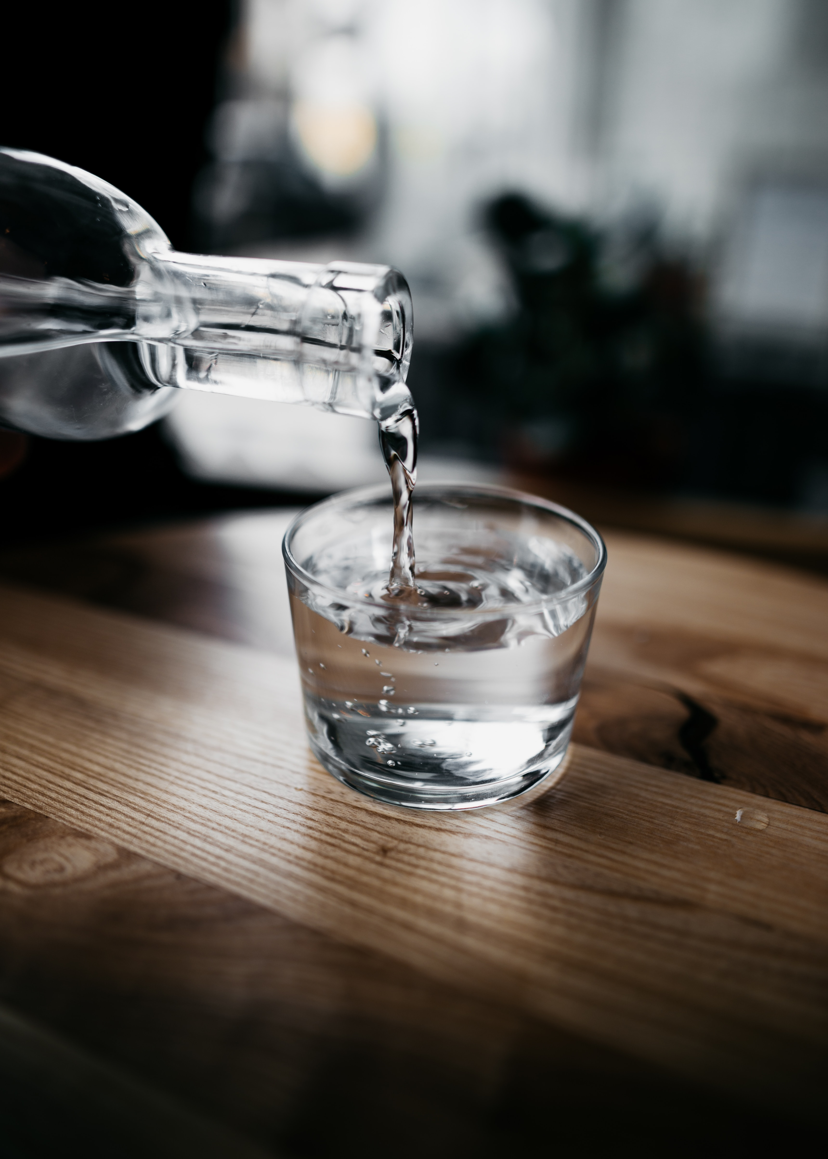
INTRODUCTION
Why WATER?
Promoting healthy habits
Maintain adequate water intake
Track hydration levels easily
Overall well-being
3
Notes:
3

Slide 4
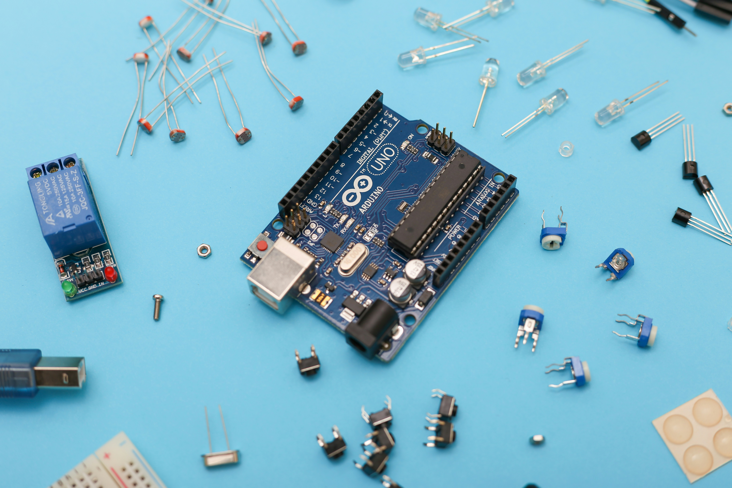
OPERATION
Users fill the bottle with water, and the water level sensor continuously monitors the water level. As a person drinks from the bottle, the system updates the water level and increments the cup count accordingly.
Demonstrating video
4

Slide 5
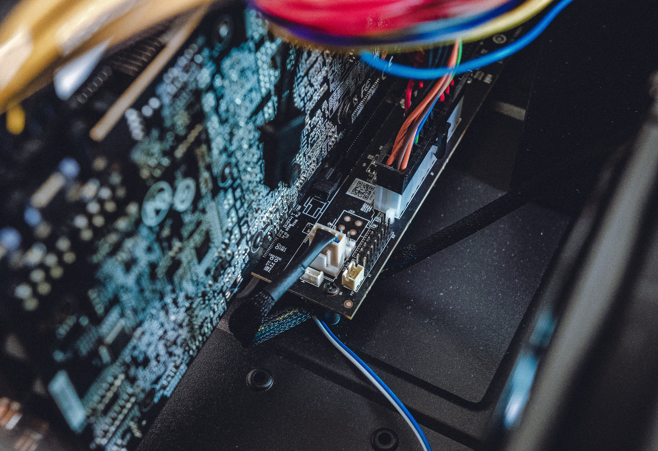
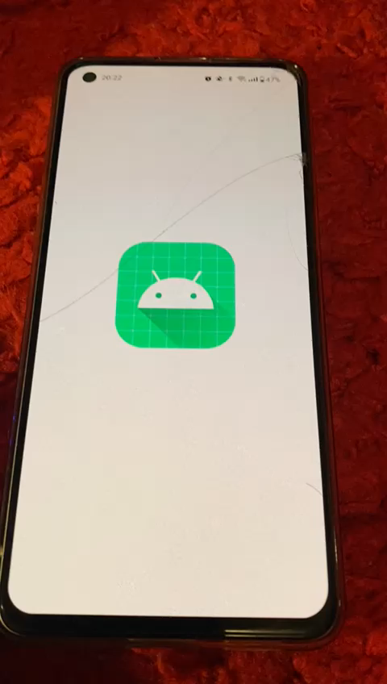
‹#›

Slide 6
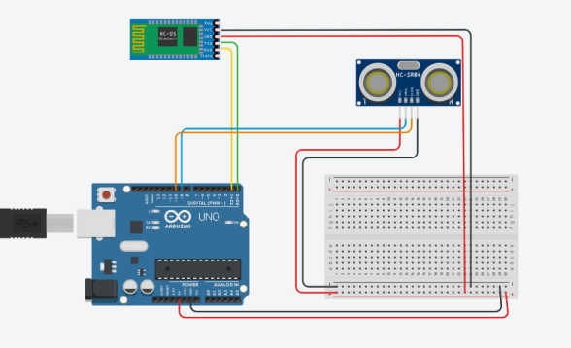
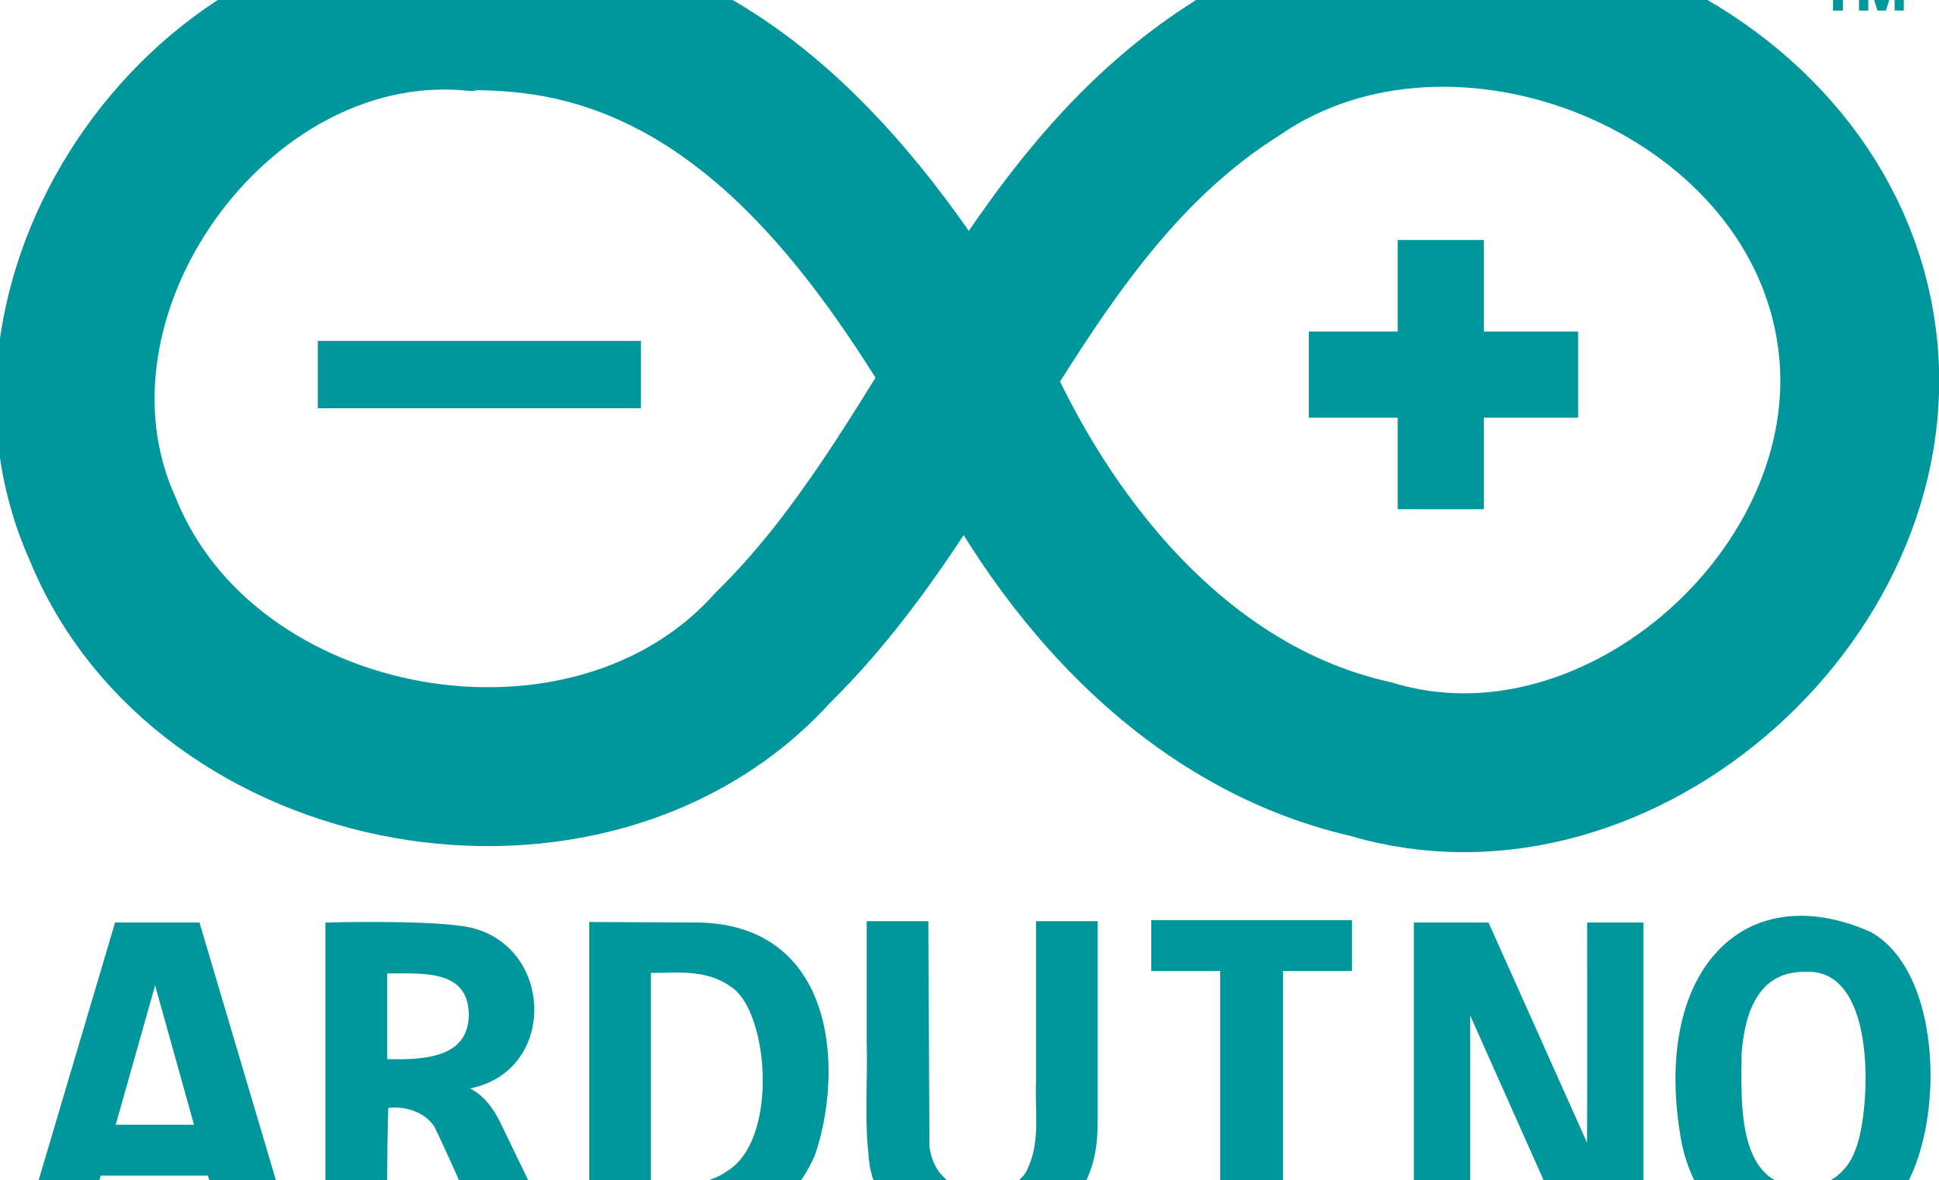

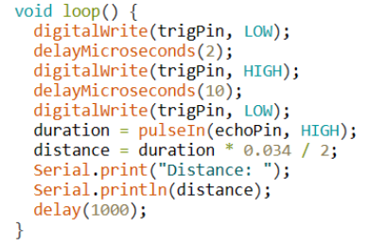
IMPLEMENTATION
CIRCUIT AND WIRING DIAGRAM
Arduino Uno
Ultrasonic Distance Sensor
Bluetooth Module
Breadboard
Wires
ARDUINO IDE
ANDROID STUDIO
Bluetooth setup with bluetoothAdapter and bluetoothSocket
Data processing
Percentage calculation
Total cups calculation
12

Slide 7

What’s next
FUTURE IDEAS
Smart reminder
Customizable goals
4

Slide 8
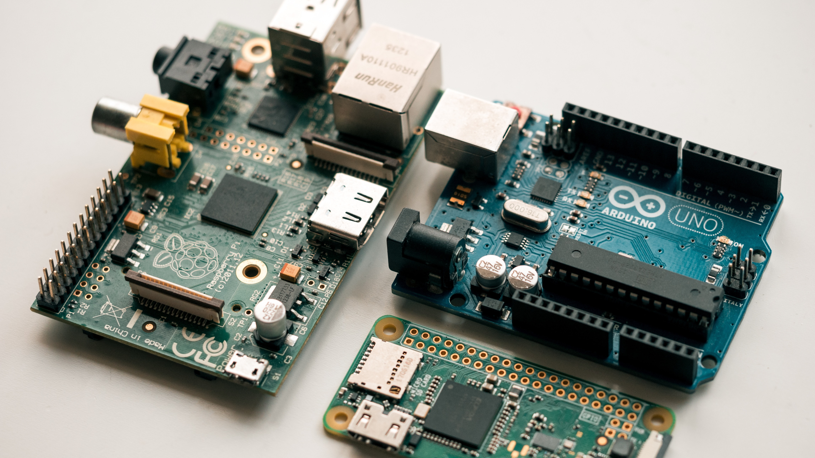


THANK YOU

